Slide 1
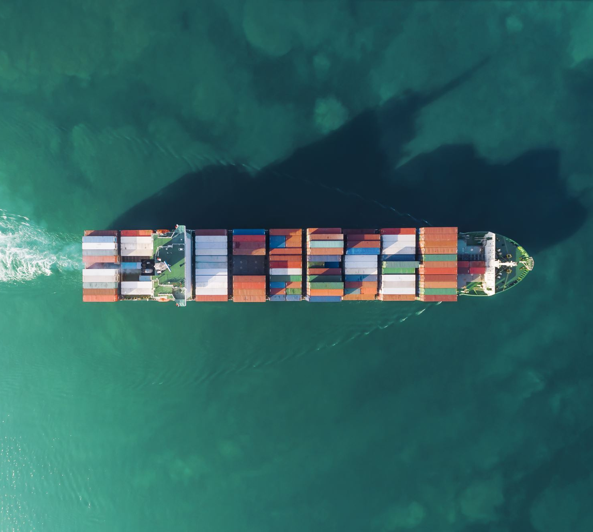

Analyzing Ocean Carrier Alliances
Adam Wilson, M.S.
Jake Wagner, Ph.D.
Eric Jessup, Ph.D.
Transportation Research Group
School of Economic Sciences
College of Agriculture and Natural Resource Sciences

Slide 2
What are Ocean Carrier Alliances?
Cooperative sharing agreements between maritime freight carriers
e.g., Maersk will carry some cargo for Mediterranean and vice versa
Alliances allow carriers to offer additional services (e.g., additional lanes) and more efficiently allocate capacity.
Carriers can utilize larger ships by filling volume from other carriers.
The impact on shippers/consumers is not well studied.
For example, carriers sometimes offer very low prices on otherwise-used capacity in order to minimize empty haul. Under an alliance agreement, this capacity might be sold at normal prices to another carrier.
Notes:
Cheap rates on excess capacity can be vital for ag producers

Slide 3
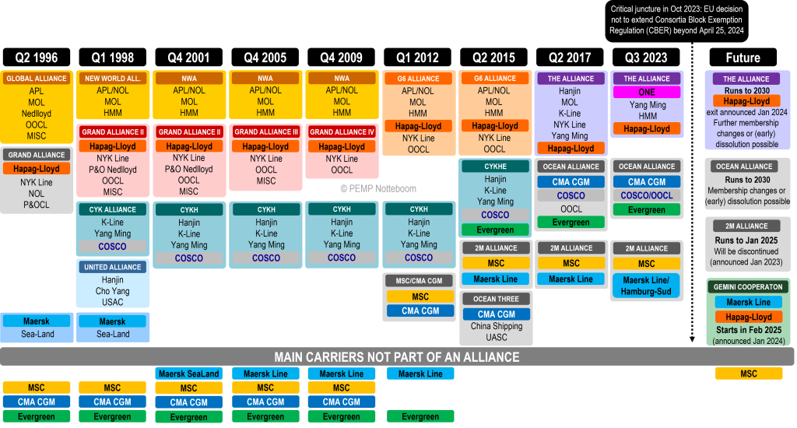
A Brief History of Alliances
Source: Theo Notteboom, PEMP
Notes:
Port Economics, Management, and Policy
Carriers on bottom are some of the largest in the world
~2013-2015 was a major transition

Slide 4
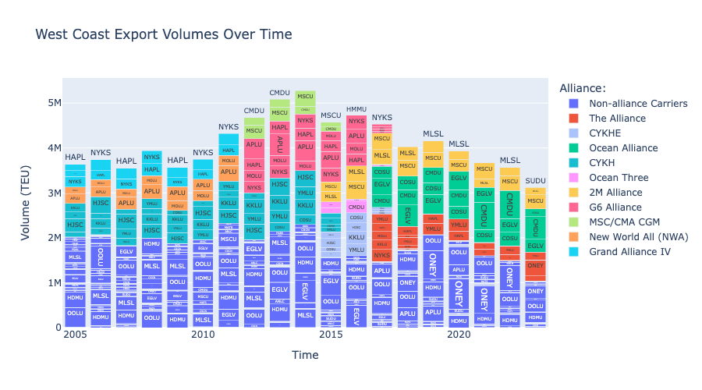
Notes:
Our first task is to study impacts of alliances on US ag producers
Since this is PNREC, we look at west coast only
Data is from 15.5M bills of lading - all maritime exports since 2005

Slide 5
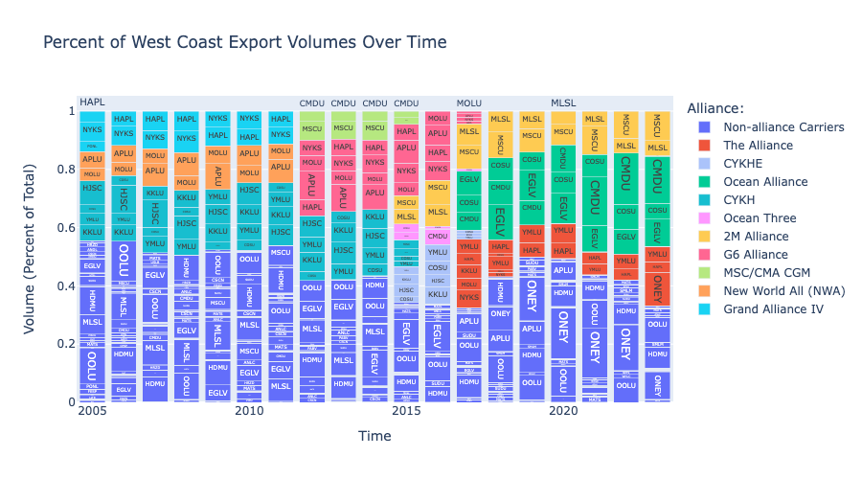
Notes:
Normalizing to % of total reveals how much market share these alliances represent
2023 - 3 alliances account for ~2/3 of exports
Globally, >3/4 of capacity sails under an alliance flag

Slide 6
Do Alliances Reduce Competition?
Carriers argue that alliances increase efficiencies, helping keep costs down and allowing them to provide better service.
Shippers and regulating bodies are concerned that Alliances give carriers too much market power
Anecdotal reports from US producers include high prices, reductions in frequency of service, and reduced delivery windows
Alliances have historically been exempt from antitrust regulation
This tide may be changing: EU exemption expired in April, and US is investigating similar moves

Slide 7
Why should we care?
90% of world trade (Source: OECD)
3% of global green house gas emissions (Source: UNCTAD)
Small changes make big differences
Experimental wing design on a single ship saved 3 tonnes of fuel per day and 11.2 tonnes of carbon emissions
Competitive markets are assumed to be more efficient
This should be held in balance with physical efficiencies and environmental impacts
Alliances aren’t just bureaucratic paperwork! Carriers change their behavior dramatically based on alliance membership.

Slide 8
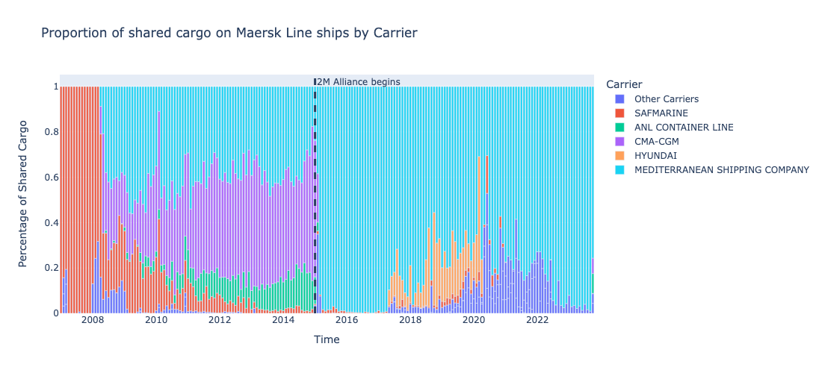
Notes:
Who Maersk shares with

Slide 9
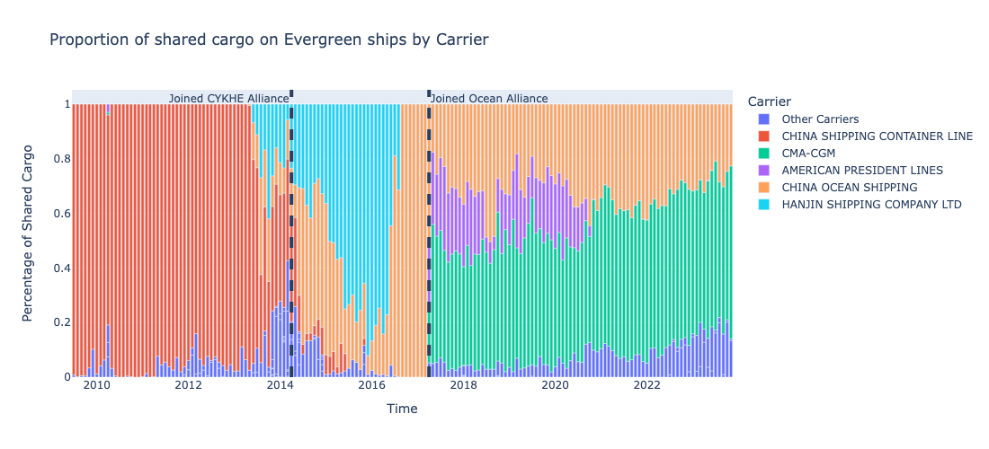

Slide 10
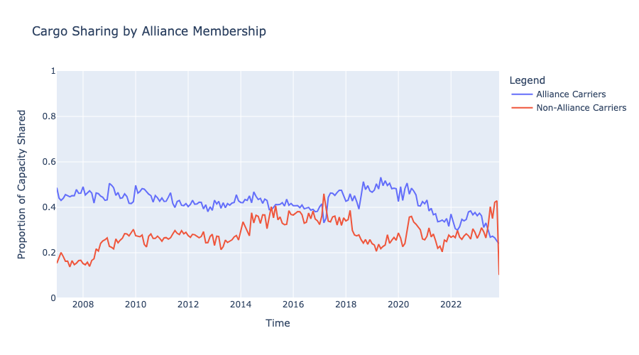
Notes:
Carriers in Alliances share cargo at higher rates than carriers not in alliances

Slide 11
Measuring Alliance Activity
Do Alliances make maritime shipping more efficient?
Do Alliances give carriers too much market power?
None of these concerns are well-studied in peer-reviewed literature.
Premise: Impacts of alliances depend on how much carriers utilize the alliance
To our knowledge, this has not been done.

Slide 12

Measuring Utilization
Alliances are not utilized on all lanes, and utilization varies over time.
Premise: Impacts of Alliances on a given lane are proportional to utilization
We are developing a metric for Alliance utilization based on cargo sharing behavior
$$Alliance Utilization = \frac{Capacity Shared with Allied Carriers}{Total Capacity Shared}$$

Slide 13
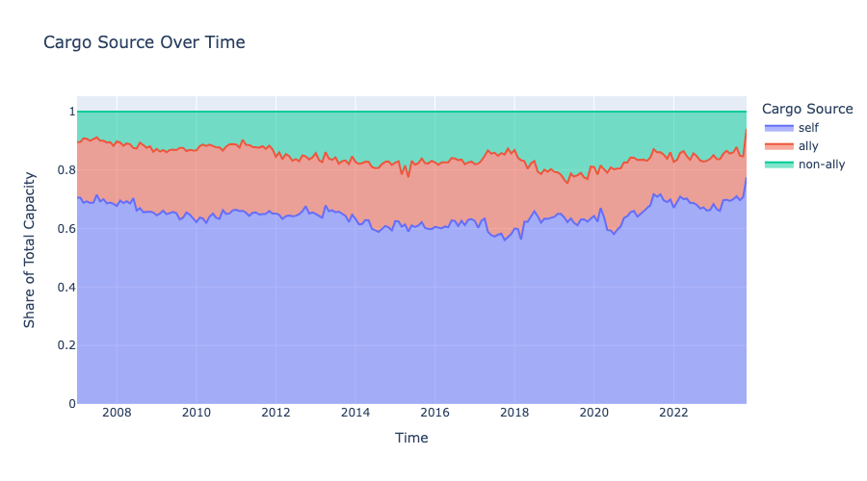
Notes:
Cargo sharing is very important
Varies over time

Slide 14
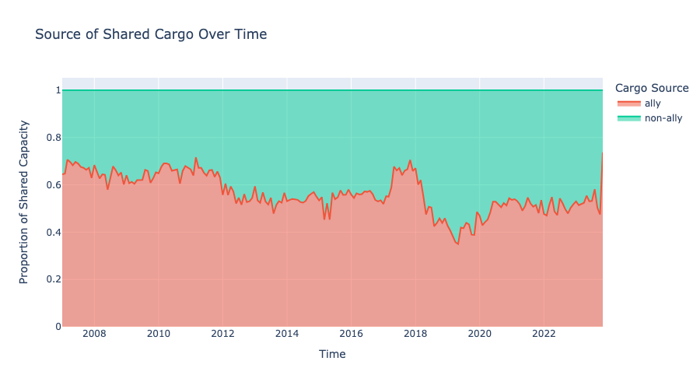
Notes:
Zooming in on the proportion of shared cargo that goes to allies gives us our Alliance Utilization metric

Slide 15
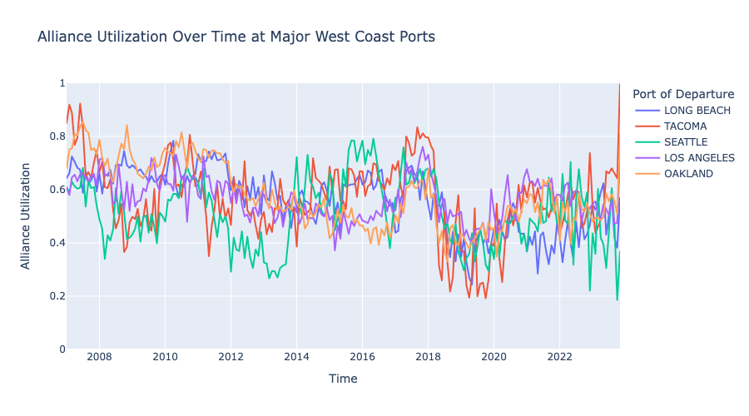
Notes:
Quite a lot of variance not just over time but also between ports

Slide 16
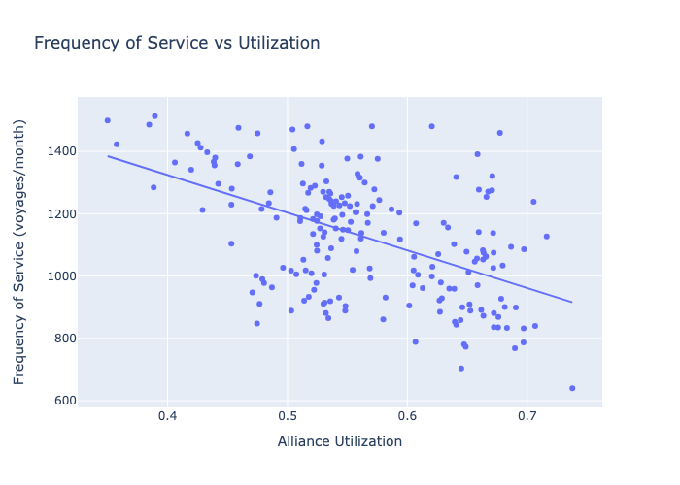
Notes:
Alliance utilization is correlated with reductions in service frequencies
What else could be causing this correlation?
We don't (yet) have a good way of measuring vessel size

Slide 17
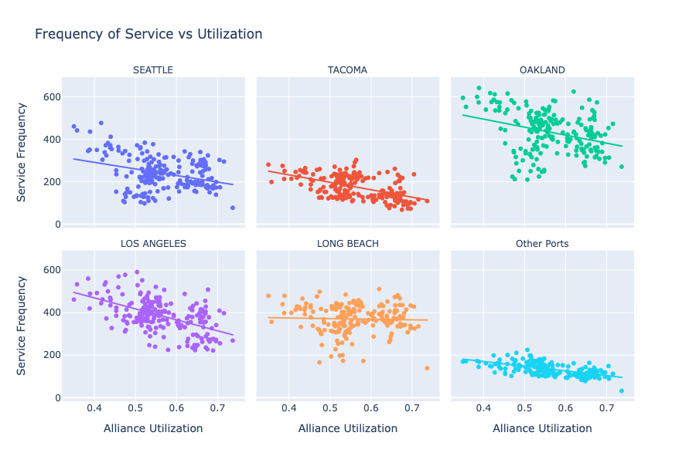
Notes:
The relationship between utilization and service frequency varies from port to port

Slide 18
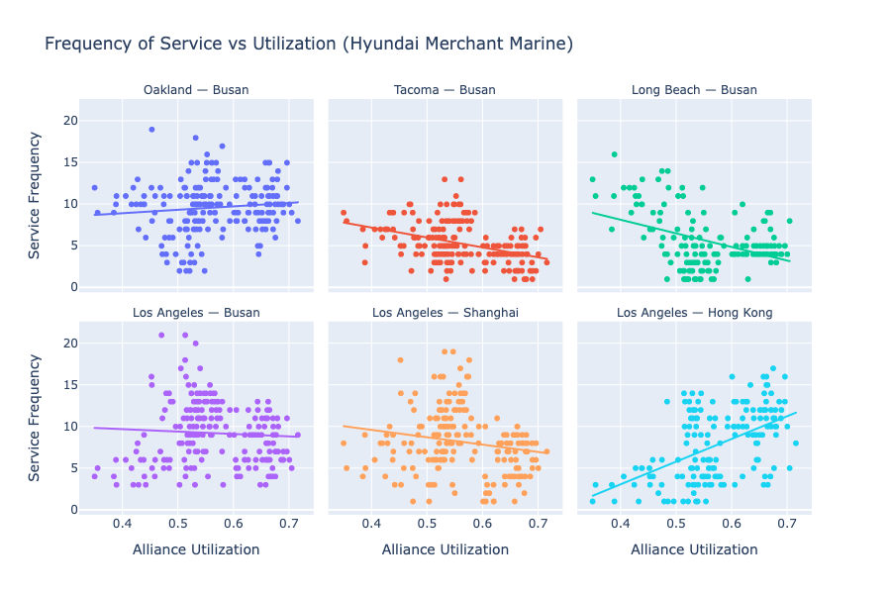
Notes:
Also varies across lanes for a given carrier
Higher utilization = less frequent service LB to Busan
Higher utilization = more frequent service LB to HK

Slide 19
Limitations
The PIERS data do not include empty haul
We also have a few data integrity issues to iron out
Utilization metric does not perfectly capture all alliance behaviors (e.g., carriers may deploy larger ships with more room to share)
Alliances are only one form of vessel sharing agreements; we do not observe any other form of these agreements.
Other limitations, probably. We’d love to hear from you!

Slide 20
Concluding Remarks
Carrier Alliances are a big deal.
Policy makers need better research to make difficult decisions.
Alliance utilization varies over time and across lanes
Impacts on producers depend on utilization of the alliance.
Questions and comments welcome!
adam.wilson1@wsu.edu

